Slide 1

Columbia Asia Hospital By: Suman Bera Date: 09-03-2024

Slide 2

Agenda
Introduction
Problem Statement
Brief Overview of Columbia Asia Hospital system
Analytical Approach and Tools
Dashboard and Visualizations
Summery
Conclusion

Slide 3

About Columbia Asia
Columbia Asia is a Malaysian subsidiary of the American private healthcare conglomerate Columbia in 1996.
Its first hospital opened in 1997 in Sarawak, East Malaysia (Mukhtar, 2021).

Slide 4

PROBLEM STATEMENT
The healthcare industry continuously strives to understand patient demographics and their healthcare utilization patterns to optimize services and improve patient outcomes.
This presentation focuses on analyzing department referrals, physician billing patterns, Satisfaction score and revenue generated for 2019 & 2020.
Let us also see in detail regarding patient’s age group, visits w.r.t to AM/PM, Wait time etc.

Slide 5

Brief Overview of Columbia Asia Hospital system
Total number of Patients across the Hospital : 9216
Total Revenue generated throughout the month: $509.31 Million
Number of Doctors available: 22
Number of available Departments: 7
Average Satisfaction score given by the Patients: 5.47 for the services
Highest visited department: General Practice.
By this report, we will understand the procedure and practices of Columbia Asia Hospital, their services, their profits, gender/race basis analysis and much more.

Slide 6

Analytical Approach and Tools
Data Cleaning: Utilized functions using Power Query Editor to check column status, health, Null values etc.
Data Enrichment: Enhanced the dataset with additional variables using different DAX functions to cross reference external data sources.
Descriptive Analysis: Employed New measures for summarizing key metrics and identifying distribution patterns across different departments and Patient category.
Visualization: Created dynamic charts and Reports for data representation, enabling interactive data exploration.
This Photo by Unknown Author is licensed under CC BY-NC-ND

Slide 7
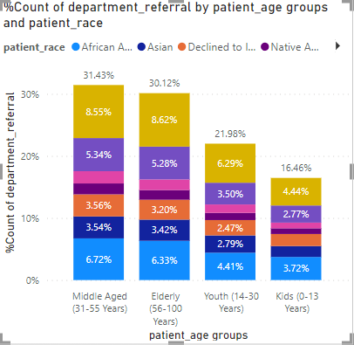
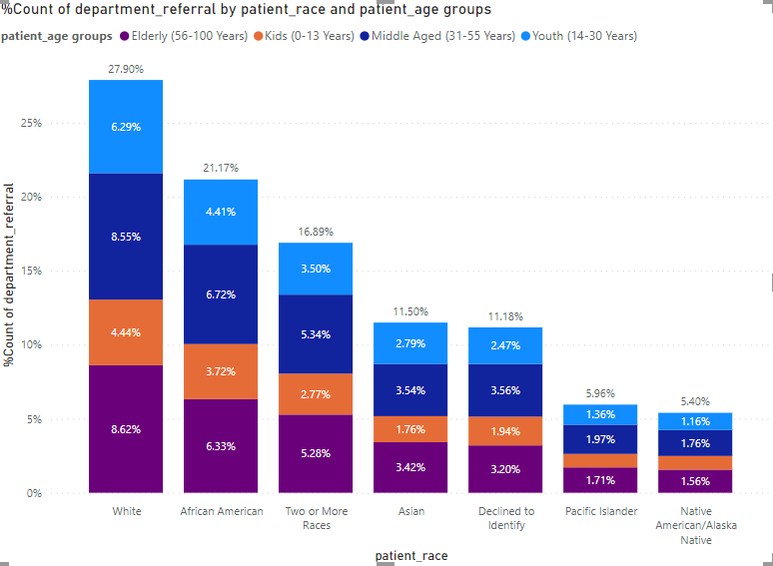
Demographics vs frequency of visit analysis
We can understand from this analysis is the most referred Race is White and its more than 25% of total referrals
whereas the least referred Race is Native American, lesser than 6% of total refers.
Also, for the highest referred age group is Middle aged (31-55 yrs) people and lowest are the Kids (0-13 yrs) depending on department referral percentage.

Slide 8

PROFIT ANALYSIS
We can understand the profit if we take total appointment fees as total expenses, and subtract it with total revenue generated, we get the Total Profit of $503.96 Million
Profitability of this margin shows how well-known the hospital is and gives a great motivation to the doctors and as well as its management to grow its services more and more

Slide 9
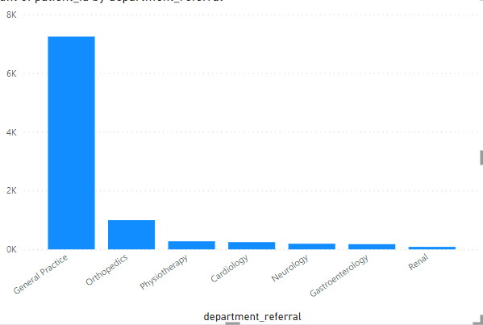
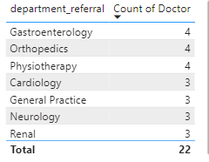
New doctor hiring ideas
As per analysis, departments which have the highest patient visits and lowest doctors in comparison to others should hire the new doctors, we can clearly check it in the below mentioned chart
So, as per the charts, the Highest visited department is General practice, but the count of doctor is lower than other departments, where we can hire more doctors to compensate and ask them to work shift-wise.

Slide 10

DISCOUNT STRATEGIES
Senior Citizen Discounts
Utilizing demographic information allows for precise targeting of discounts based on age groups that comes under senior citizen above 60 and provide them some discounts
Package Deals
Creating bundled packages encourages patients to utilize more services while saving money, thus increasing overall revenue, and promoting comprehensive healthcare.
Promotional Discounts
Running promotional campaigns with limited-time discounts on select services or procedures can attract new patients and incentivize existing patients to utilize additional services, contributing to revenue growth and patient retention.

Slide 11
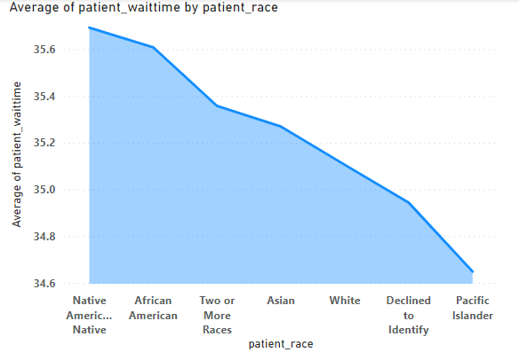
GENDER/race BASED DISCRIMINATION THEORY
We can check the Gender inequality by making a chart between patient race in X axis and % of Department count in Y axis putting age groups as legends:
Here from this chart, we can clearly see the most referred Race is White and its more than 25% of total referrals, whereas the least referred Race is Native American, lesser than 6% of total refers.
Also in the 2nd chart, we can clearly see the Native people had to wait longer than white people. This concludes the fact that the claim on Gender discrimination is justified but in very minimal scale.

Slide 12

EXPLANATION OF APPROACHES
Here's how I would approach identifying objective and subjective questions in a hospital management system using Power BI, even without pre-defined categories:
Explore the Data Available: Start by familiarizing myself with the data model in Power BI. Looking at the available tables and fields, understanding what data points they represent.
Identify Measurable Metrics: Focusing on fields with numerical values, percentages, or rates. These are likely objective data points suitable for answering objective questions.
Look for Trends and Patterns: Use visualizations like charts and graphs to identify trends and patterns in the objective data. These patterns can lead to the formulation of objective questions.
Consider Potential Subjectivity: While objective data dominates, some analysis can reveal opportunities for exploring subjective aspects.
Leverage DAX Calculations: Power BI's Data Analysis Expressions (DAX) allow you to create new calculated fields based on existing data
Ask "Why" and "How": As I explore the data, asking myself "why" and "how" questions about the trends and patterns I observe. These questions often lead to objective inquiries you can answer with data analysis.

Slide 13
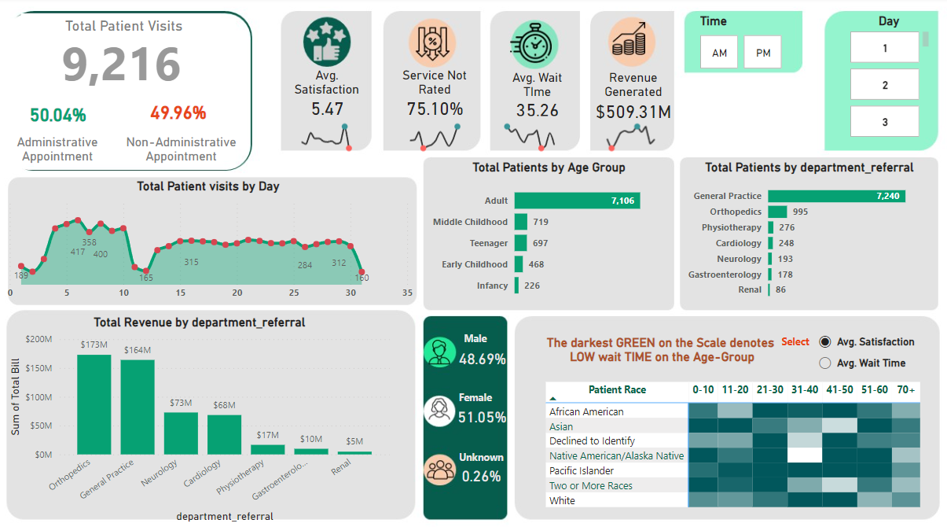
REPORTS and Visualizations

Slide 14
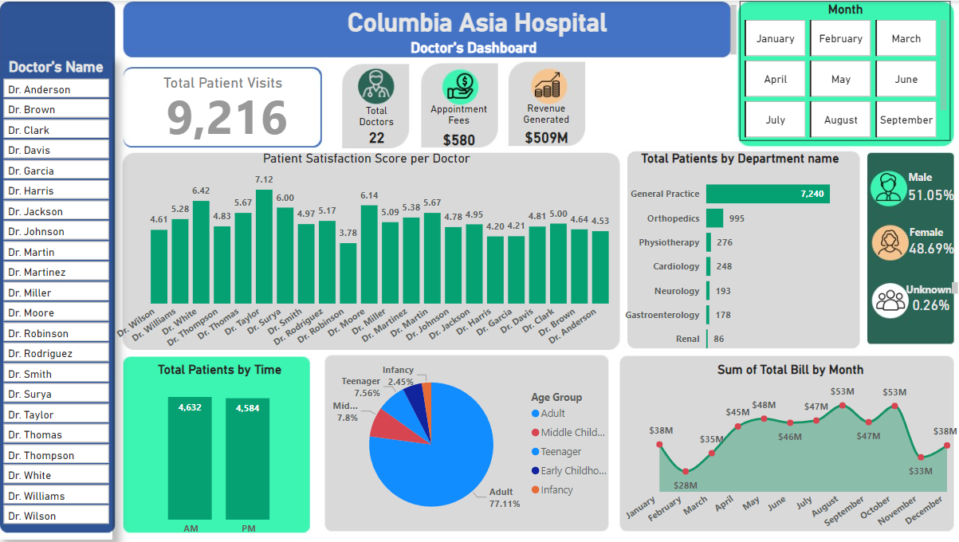
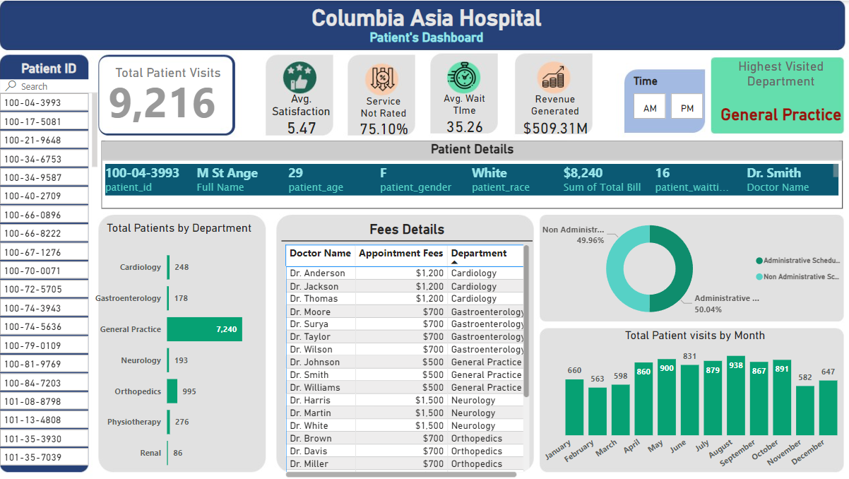
Areas of focus
We have created 3 Reports Based on the requirements:
In the Main Tab, I have used slicers on Date and Moments (i.e., AM; PM) to quantify the overall metrics running throughout the day in the hospital.
Using the Doctors’ Tab, we would be able to look at the individual doctor’s performance metrics like customer satisfaction, the number of patients he was visited, by the revenue he has generated, and his appointment fees. This tab does have a slicer of the Doctor's Name for easy workarounds.
Using the Patients’ Tab, we can look at a customer’s profile which would involve metrics like the most frequently visited department, their age, their race, their waiting time, number of visits, the total amount that they have paid to the hospital, etc. We would be able to see all the details in a single report along with an Interactive slicer of Patient’s ID

Slide 15

SUMMARY
Columbia Asia Hospitals are known for their focus on efficiency and affordability. This project report likely details the planning and execution of a great hospital management system by its aspects and. It might delve into aspects like:
Services Offered: The specific medical specialties the hospital will cater to all age and races’ patients.
Project Management: Strategies to ensure the project stays on schedule and within budget.
By outlining these elements, the report provides a roadmap for establishing a new Columbia Asia hospital that delivers quality healthcare at an accessible cost.

Slide 16

Thank you
Suman Bera
7501823400
sumanbera.123@outlook.com

